Slide 1
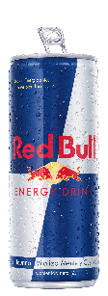
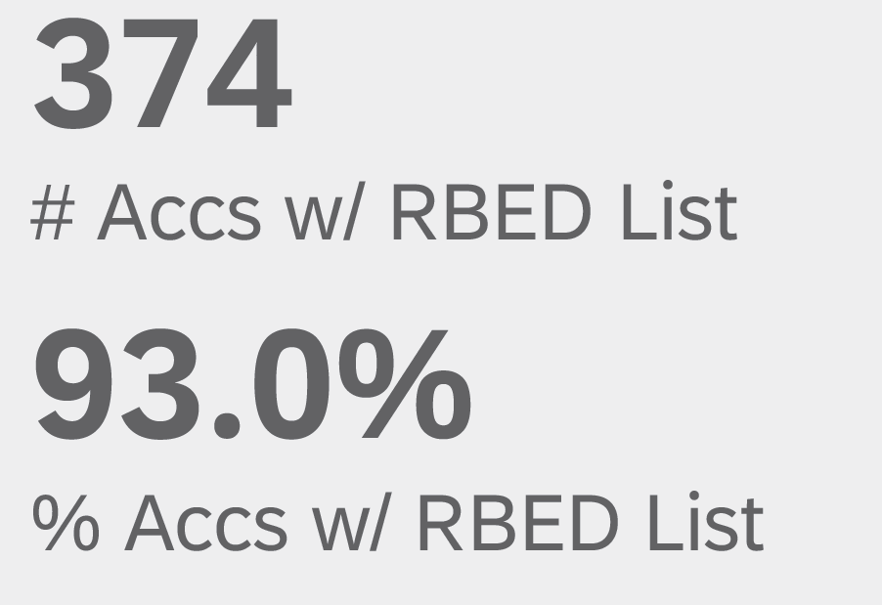
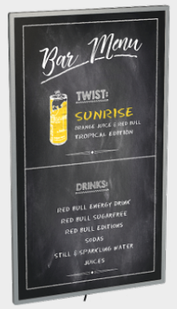
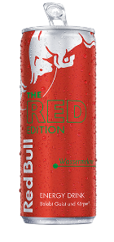
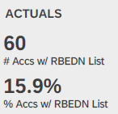
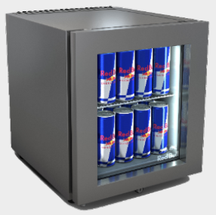
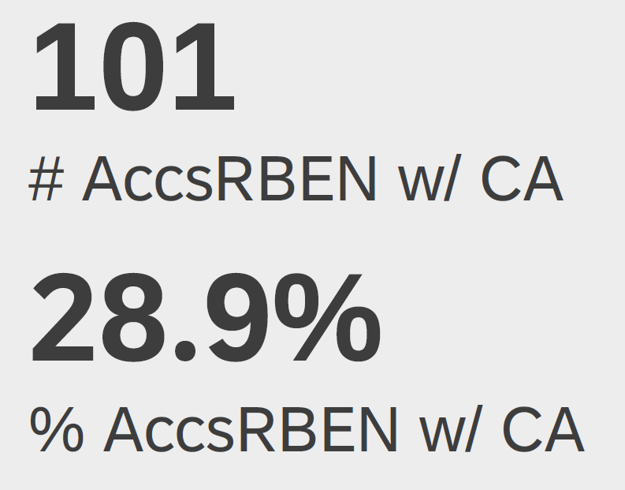
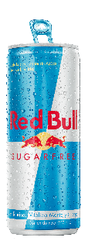
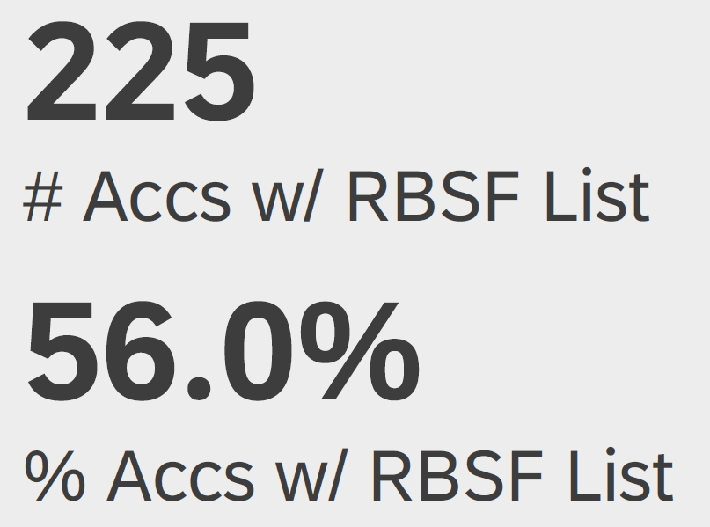
O N
P R E M I S E
BOGOTÁ NORTH |UNIVERSE & EXECUTION
OVERVIEW
SKU LISTINGS
CONSUMPTION ACTIVATION,
MENU LISTING, COOLER & DiPo´s
C.A. P YTD: 46
C.M.E. P YTD: 27
Total Coolers: 141
Cooler P YTD:
Cooler Pen: 24,9%
Total DiPo´s: 5
DiPo´s P YTD:
Dipo´s Pen: 1%
TAT ON VALUE SHARE (NIELSEN)

Slide 2
O N
P R E M I S E
BOGOTÁ NORTH
-26,69%
YTD VS 2019
TOTAL VOLUME
+98,56%
YTD VS 2019
VOLUME MUSK UNIVERSE
-19%
YTD VS 2019
YTD VS SRE
+185%
YTD VS PY
BY SEGMENT
(SPLIT) VOL BP-SER-FRE
BDR´S YTD
VS FRE
TAT YTD
VS FRE
BY CLASSIFICATION
(SPLIT) *DASHBOARD

Slide 3
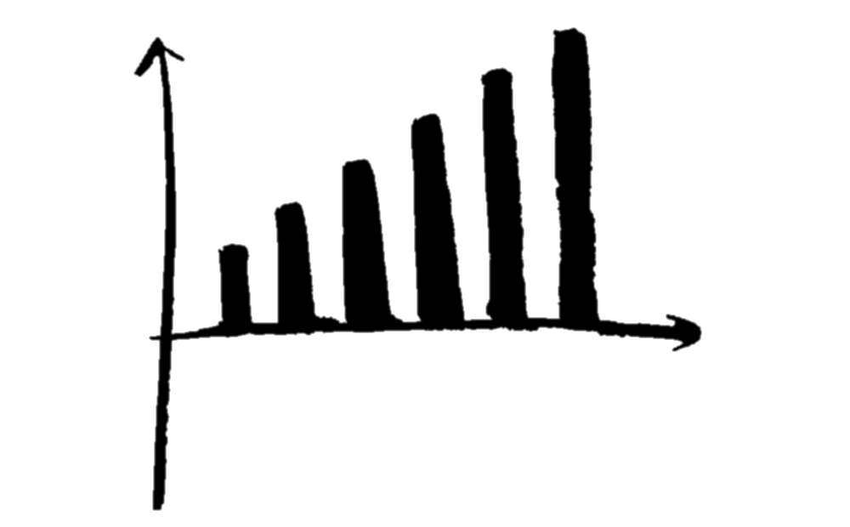
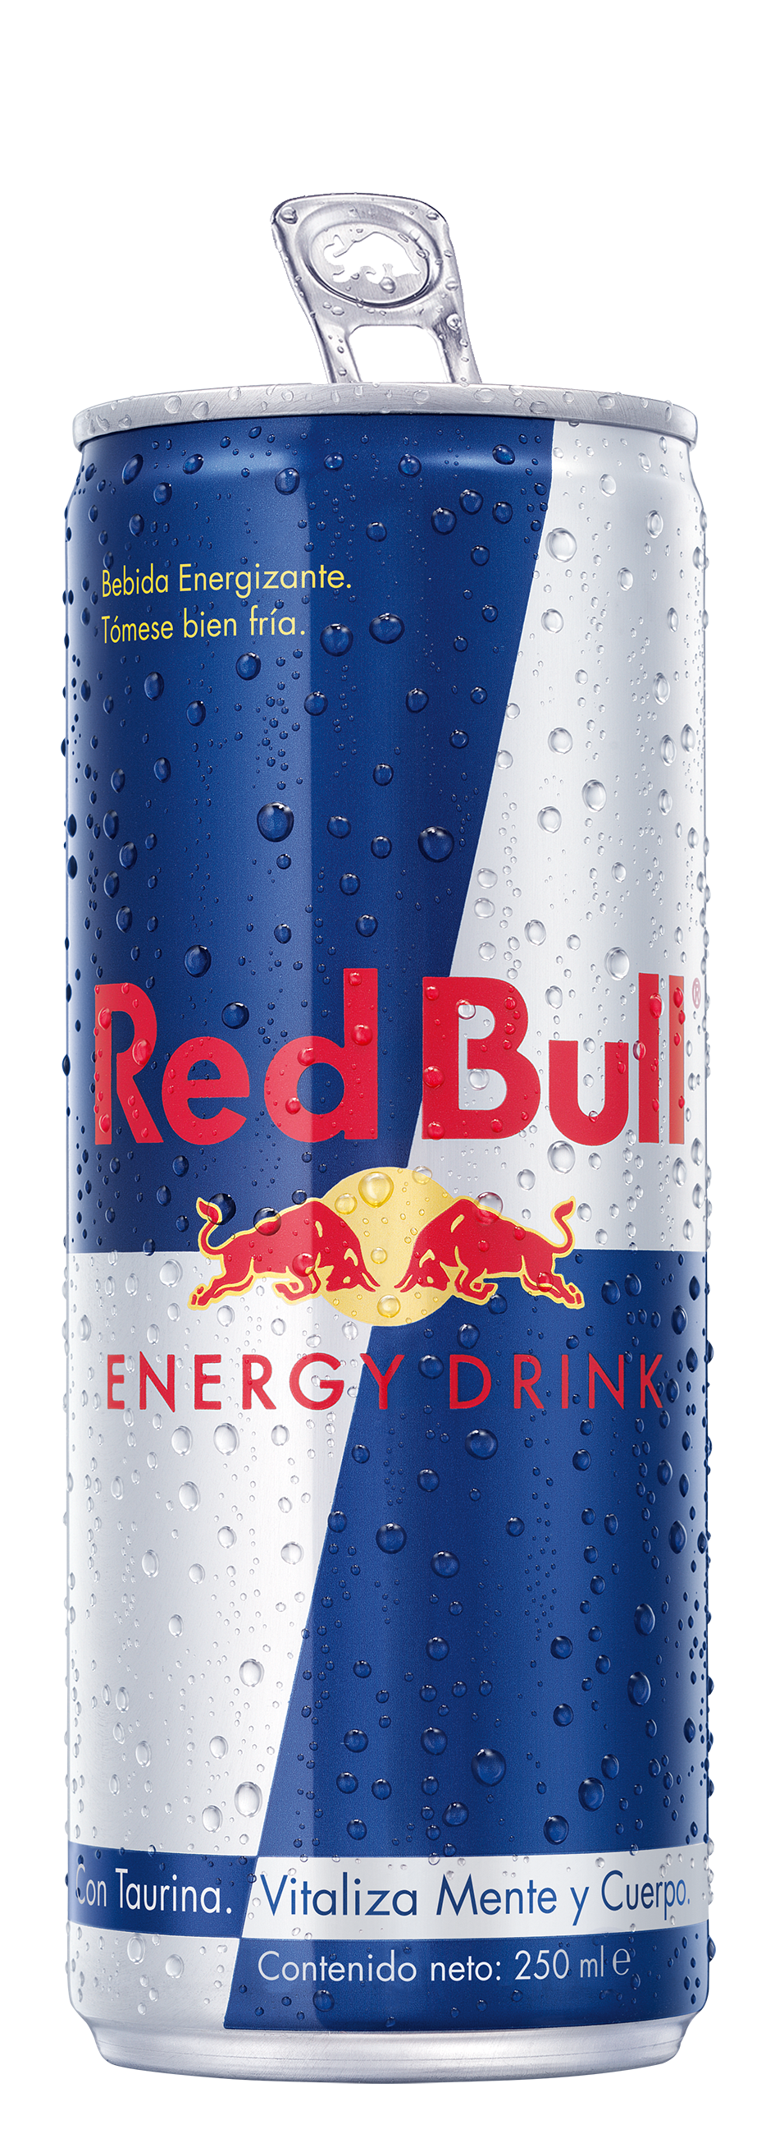
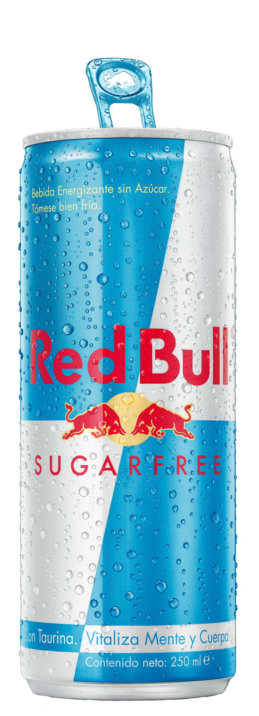
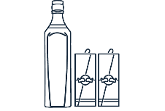
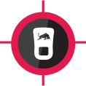
volume
P.O.D & TRIGGERS
KEY 3 &
BAR CALL
ipc
H5
TRIAL & INDUSTRY
THE GHETTO PROJECT
bar
Energy drink
B.G.: 2 x year
sugarfree
1.400 COP
A top
TRENDSETTER
2019: 17.088
2020: 4.152
2021: 8.700
Staff
Menu
red
combos
TRIAL @RED BULL NIGHTS 2 PER SEMESTER
BAMBULÉ
BAR
Energy drink
1 B.G. & B.S.T
X SEMESTER
sugarfree
1.220 cop
A Image
HIGH SOCIETY
2019: N/A
2020: N/A
2021: 3.312
STAFF
TABLES´ communication
combos
TRIAL: venue´s big moments
4 40
Bar
TABLE
Energy drink
1 B.G. & B.S.T
X SEMESTER
sugarfree
1.220 cop
B
HIGH SOCIETY
2019: 5.016
2020: 1.828
2021: 5.382
Staff
Qr stickers
combos
TRIAL: venue´s big moments
VAPIANO
table
Energy drink
staff
sugarfree
N/A
B.S.T.: 2 x SEMESTER
A Image
2019: N/A
2020: N/A
2021: 552
TRIAL: Saturday to launch red edition
CABRERA
Energy drink
2 B.S.T. X semester
TABLE
sugarfree
N/A
b.g. with red relaunch
A Image
HIGH SOCIETY
2019: 1.424
2020: 1.020
2021: 2.291
TABLE TALKERS – STAFF - menú
Red edition
twist
TRIAL: support b.g. of red relaunch
ÍSOLA
TABLE
Energy drink
2 B.S.T. X semester
sugarfree
N/A
b.g. with red relaunch
A Image
HIGH SOCIETY
2019: 1.164
2020: 912
2021: 1.944
TABLE TALKERS – STAFF - menú
Red edition
Red gin
TRIAL: support of red relaunch
FENIX
TABLE
Energy drink
B.G.: 1 X SEMESTER
sugarfree
1.860 cop
B.S.T.: 1 x SEMESTER
A Image
HIGH SOCIETY
2019: N/A
2020: 1.436
2021: 1.320
TABLE TALKERS – STAFF - menú
tropical
twist
TRIAL: special events
During each b.g.
Blind passenger

Slide 4
volume
P.O.D & TRIGGERS
KEY 3 &
BAR CALL
ipc
H5
TRIAL & INDUSTRY
CLANDESTINO
bar
Energy drink
B.g. of season´s brunchs (tbd)
TRIAL: @brunchs (each 15 days)
2019: 11.112
2020: 3.095
2021: 7.108
sugarfree
496 COP
b
HIGH SOCIETY
Staff
menu
Combos*
SALVADOR
bar
Energy drink
2 B.S.T. X semester
sugarfree
n/a
b.g. with red launch
b
HIGH SOCIETY
2019: 2.064
2020: 1.680
2021: 2.110
Staff & menu
TRIAL: @venue´s big moments
LA BEBETA
TABLE
bar
Energy drink
B.G.: 2 X SEMESTER
sugarfree
389 cop
B.S.T.: 2 x SEMESTER
A Image
HIGH SOCIETY
2019: N/A
2020: N/A
2021: 2.600
staff
Red edition
Blind passenger
EL FABULOSO
bar
Energy drink
2 x semester
Staff
tables
sugarfree
389 cop
B.S.T.: 2 x SEMESTER
A Image
HIGH SOCIETY
2019: 4.944
2020: 2.088
2021: 3.444
Red edition
twist
TRIAL: events each 15 days
Blind passenger
SOLAR
Energy drink
B.G.: 1 X SEMESTER
TABLE
sugarfree
1.860 cop
B.S.T.: 1 x SEMESTER
A Image
HIGH SOCIETY
2019: N/A
2020: 3.496
2021: 3.888
TABLE TALKERS – STAFF - menú
tropical
twist
TRIAL: special events
During each b.g.
Blind passenger
EL COQ
Bar
table
Energy drink
B.G.: 1 X SEMESTER
sugarfree
n/a
B.S.T.: 1 x SEMESTER
A Image
HIGH SOCIETY
2019: 2.388
2020: 744
2021: 2.168
Table tents
staff
TRIAL: karaocoq (tbd)

